Slide 1

Vehicle Valuation
Predicting Car Prices through Machine Learning

Slide 2
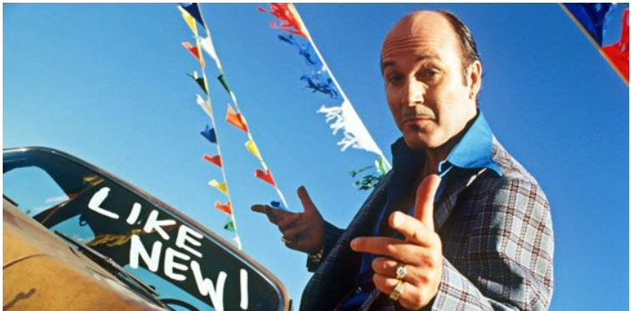
Why Used Car Sales?
A 2023 survey by USA Today found that trust and transparency is the biggest factor when buy a car.
Enhanced digital tools can help improve transparency.
“More than three-quarters (77%) of car buyers say dealers should provide more information upfront about pricing and financing, so car buyers are better informed.” – USA Today, 1-31-2023, Stephanie Walden, https://www.usatoday.com/story/sponsor-story/capital-one/2023/01/31/new-survey-finds-trust-key-successful-car-buying-experiences/11150069002/
With so many factors involved with a vehicle purchase, we wanted to empower buyers by providing a starting point for negotiations to streamline the car purchasing experience.
We wanted to develop a digital tool to help improve car valuation transparency.

Slide 3


Executive Summary
Project Goals
Project Overview
Develop a Machine Learning Model with meaningful predictive power using a large, feature-rich dataset.
We avoided using time-series data so as not to repeat our last project.
We obtained data through a source dedicated to data exploration.
We chose a dataset that looked feature-rich and built out our project from there.

Slide 4

Data Collection
Initial dataset contained 19,000 rows, and 18 Features containing various vehicle attributes including:
Price
Production Year
Color
Fuel Type
Mileage
Make
Model

Slide 5
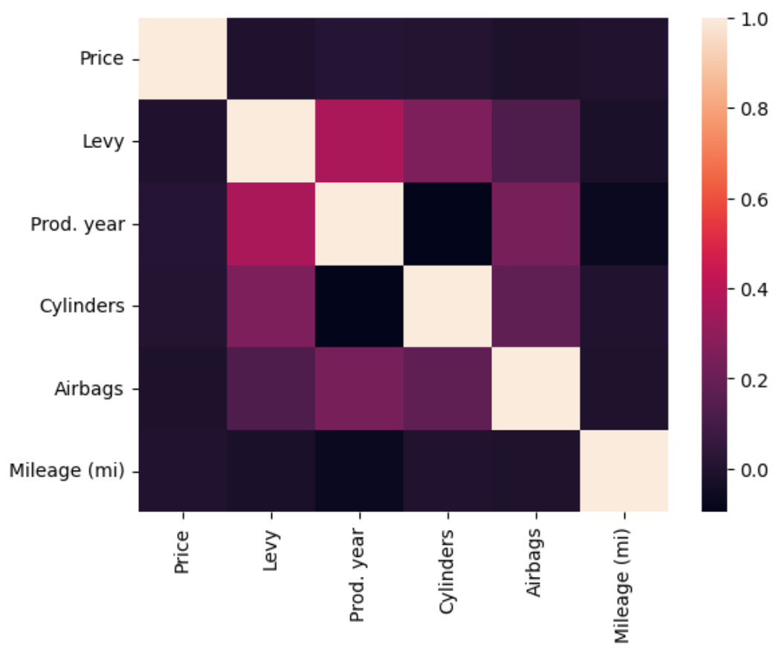
Data Exploration
The data set contained 1590 unique make and models.
We checked to see which columns were numerical and which were objects
9 Numeric
9 Categorical
We checked the distribution of all categorical variables and found two heavily imbalanced (columns where 90% of the data was weighted
Steering wheel column (Left or Right) – Majority were left-side
Number of doors (2 or 4) – Majority were 4-door
We found no direct correlation between price and the other numerical features.

Slide 6
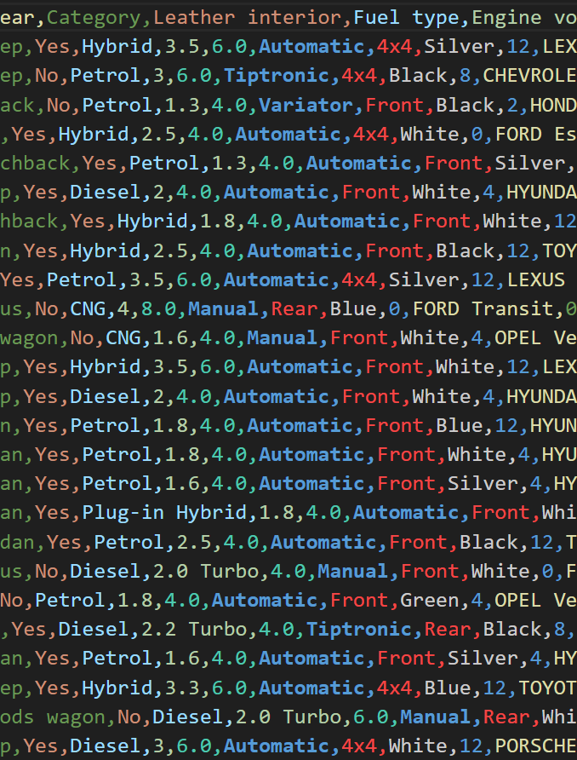
Data Cleanup
We first needed to identify features that had no appreciable impact on price, such as the ID column.
We stripped unnecessary characters in the numeric data and converted the columns to the correct data type.
We converted mileage to miles, because this is America.
We combined make and model columns.
We dropped heavily imbalanced columns.
We checked for NaN data and found none.
We saved the resulting data into a new CSV file.

Slide 7


Approach
Split the pricing column from the rest of the dataset using TrainTestSplit.
Encoded categorical data, by fitting it on the training data and transforming the testing data using OneHotEncoder.
Merged the encoded and numeric data back together.
Created a list of regression models to utilise.
Linear Regression
Logistic Regression
Decision Tree
Random Forest
Gradient Boosting
Extra Trees
Fit each model and scored it using R2, Accuracy Score and MSE.

Slide 8

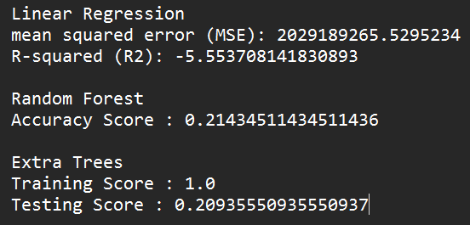
Wait, What?!
Initial scores were...not good.
It was at this point that we realized two things:
Our data needed to be re-scaled
Our outliers were skewing the results. Prices ranged between 1 and 6 million dollars.
We rescaled the data using StandardScaler
We limited our results to just vehicles between $1000, and $100,000
This still left us with 16,000 rows of data remaining.

Slide 9

Model Evaluation: Part Deux – The Second One
We re-ran our models after making corrections to our data and came up with much better results.
Of all the models we ran, RandomForestRegressor looked the most promising.
Scores were still fairly low.

Slide 10
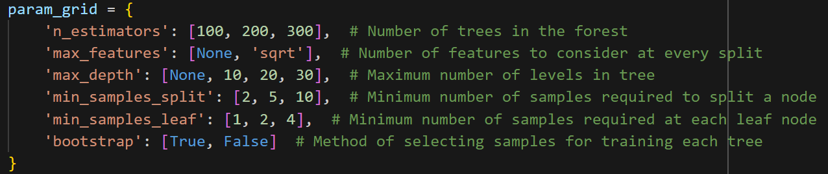
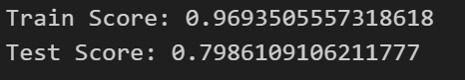
Tuning the Model
We used GridSearch and RandomizedSearch CV to identify the optimum hyper-parameters to use in our model.
Clayton ran the GridSearch CV (which took over an hour to complete)
Derek ran the RandomizedSearch CV which took around 30 mins.
We were able to refine our hyper-parameters and achieve a respectable score.

Slide 11
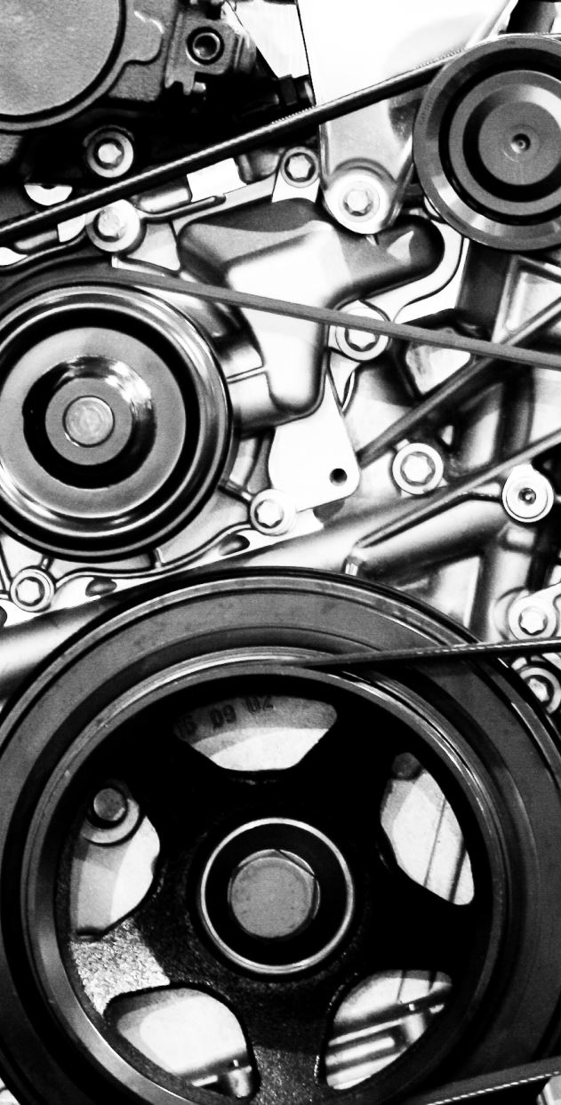
Conclusion
Ultimately, we were able to develop a machine learning model that was able to predict the value of a car based on numerous features with 80% accuracy.
If we had more time, we would have liked to have collected more car data and tuned the model even further.
We would also like to have created a front-end to input new data.
Outputting a price range rather than an exact price would have improved the accuracy even further.
Processing power played a major role in limiting the range of models and tuning methods we could test. With more power/processing time, we could have explored additional models such as ExtraTrees. We found diminishing returns when increasing the compute time. .5 accuracy is not worth an hour of process. There must be a balance between processing and accuracy.

